Slide 1
An Introduction to Network Simulator (NS-2)
Network Simulation
Dr. Uttam Ghosh
uttam.ghosh@vanderbilt.edu
Computer Science
Vanderbilt University

Slide 2
Outline
Introduction
Simulation- General Approach
Simulation- Wired
Application Protocol: FTP, CBR
Transport Protocol: UDP, TCP
Routing Protocol: Static and Dynamic (DV)
Simulation- Mobile Ad Hoc Network (MANET)
AODV, DSR, DSDV
Simulation- Hybrid (Wireless and Wired)

Slide 3
What is NS?
Event Driven Simulator
Physical activities are translated to events
Events are queued and processed in the order of their scheduled occurrences
Time progresses as the events are processed
Packet Level
Time: 1.5 sec
Time: 1.7 sec
1
2
Time: 2.0 sec
Time: 1.8 sec

Slide 4
Simulation Support
Wired Networks
Wireless Networks
Satellite Networks
InterPlanetary Networks
Wireless Sensor Networks
Vehicular Ad hoc Networks
Mobile Ad hoc Networks

Slide 5
Protocol Support
It supports all the layers of OSI
Collection of various protocols at multiple layers
Application (FTP, WWW, CBR)
TCP (reno, new reno, tahoe, vegas, sack)
MAC(802.11, 802.3, TDMA)
Queuing model
Different mobility model in case of wireless networks
Ad-hoc routing (DSDV, DSR, AODV, TORA)
Sensor network (Diffusion, Gaf)
Multicast protocols, Satellite protocols, and many others

Slide 6
NS Components
NS- Simulator
NAM- Network AniMator
Preprocessing (using C++)
Topology generator (using TCL)
Post analysis
Generates NAM (with .nam extension) and Trace (with .tr extension) files.
Trace analysis using Perl/TCL/AWK/MATLAB

Slide 7
NS Environments
Simulation Scenario
0
1
set ns [new Simulator]
set node_(0) [$ns node]
set node_(1) [$ns node]
Tcl Script
class MobileNode : public Node
{
friend class PositionHandler;
public:
MobileNode();
•
•
}
C++ Implementation

Slide 8
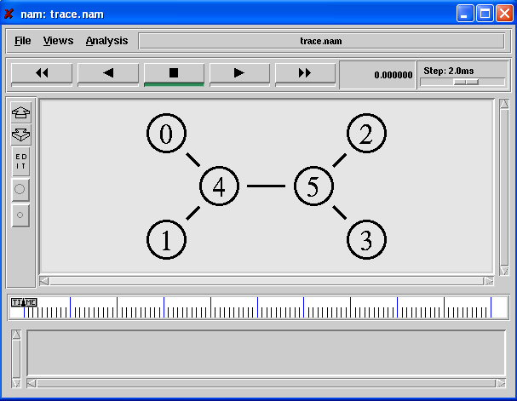
Network AniMator (NAM)

Slide 9
Trace File (a.tr)
- 0.84824 2 3 tcp 1040 ------- 0 0.0 3.0 29 46
r 0.85408 2 3 tcp 1040 ------- 0 0.0 3.0 28 44
+ 0.85656 2 3 tcp 1040 ------- 0 0.0 3.0 30 47
- 0.85656 2 3 tcp 1040 ------- 0 0.0 3.0 30 47
r 0.8624 2 3 tcp 1040 ------- 0 0.0 3.0 29 46
+ 0.86488 2 3 tcp 1040 ------- 0 0.0 3.0 31 49
- 0.86488 2 3 tcp 1040 ------- 0 0.0 3.0 31 49
r 0.87072 2 3 tcp 1040 ------- 0 0.0 3.0 30 47
+ 0.8732 2 3 tcp 1040 ------- 0 0.0 3.0 32 50
- 0.8732 2 3 tcp 1040 ------- 0 0.0 3.0 32 50
r 0.87904 2 3 tcp 1040 ------- 0 0.0 3.0 31 49
+ 0.88152 2 3 tcp 1040 ------- 0 0.0 3.0 33 52
- 0.88152 2 3 tcp 1040 ------- 0 0.0 3.0 33 52
r 0.88736 2 3 tcp 1040 ------- 0 0.0 3.0 32 50

Slide 10
NS Installation & Run
Download: https://sourceforge.net/projects/nsnam/files/latest/download
Unzip: $ tar -xzf ns-allinone-2.35.tar.gz
Need to edit the line number 137 of ~/ns-allinone-2.35/ns-2.35/linkstate/ls.h:
void eraseAll() { erase(baseMap::begin(), baseMap::end()); }
to
void eraseAll() { this->erase(baseMap::begin(),baseMap::end()); }
Need gcc version 4.8: $sudo apt-get install gcc-4.8 g++-4.8
Install allinone package: $export CC=gcc-4.8 CXX=g++-4.8 && ./install (run in ~/ns-allinone-2.35)
*Validation: $./validate (run in ~/ns-allinone-2.35/ns-2.35/)
*Configuration: $./configure ((run in ~/ns-allinone-2.35/ns-2.35/)
Notes:
*Not Needed
** There will be no source code

Slide 11
NS Installation & Run
Set path (/etc/profile):
PATH=$PATH:/home/uttam/ns-allinone-2.35/bin:/home/uttam/ns-allinone-2.35/tcl8.5.10/unix:/home/uttam/ns-allinone-2.35/tk8.5.10/unix:/home/uttam/ns-allinone-2.35/otcl-1.14:/home/uttam/ns-allinone-2.35/lib:/home/uttam/ns-allinone-2.35/tcl8.5.10/library
Either restart or use: $source /etc/profile
Automatic Installation: $sudo apt-get install ns2
Verify your installation: $ns
The output in the terminal should be %
To Run Script (e.g., Simple.tcl): ns Simple.tcl
To Run NAM (e.g., Simple.nam): nam Simple.nam

Slide 12
Simulation- General Approach
Create the simulator
Activate tracing
Create the nodes and topology
Create the links
Activate routing
Chose error model, if necessary
Create the traffic
Send application data

Slide 13
Wired Network- UDP
Application/Traffic/CBR
Agent/ UDP
Agent/ Null
1
0

Slide 14
Simulator Creation and Tracing Activation
Creating a Simulator Object
set ns [new Simulator]
Setting up files for trace & NAM
set trace_nam [open out.nam w]
set trace_all [open all.tr w]
Tracing files using their commands
$ns namtrace-all $trace_nam
$ns trace-all $trace_all
Closing trace file and starting NAM
proc finish { } {
global ns trace_nam trace_all
$ns flush-trace
close $trace_nam
close $trace_all
exec nam out.nam &
exit 0 }

Slide 15
Topology Creation
Creating two nodes
set n0 [$ns node]
set n1 [$ns node]
Creating links (topology) between two nodes
$ns duplex-link $n0 $n1 1Mb 10ms DropTail

Slide 16
Attaching Agents
Create a UDP agent and attach it to node n0
set udp0 [new Agent/UDP]
$ns attach-agent $n0 $udp0
Create a CBR traffic source and attach it to udp0
set cbr0 [new Application/Traffic/CBR]
$cbr0 set packetSize_ 500
$cbr0 set interval_ 0.005
$cbr0 attach-agent $udp0
Create a Null agent (a traffic sink) and attach it to node n1
set null0 [new Agent/Null]
$ns attach-agent $n1 $null0
Connect the traffic source with the traffic sink
$ns connect $udp0 $null0

Slide 17
Traffic Generation
Schedule events for the CBR agent
$ns at 0.5 "$cbr0 start"
$ns at 4.5 "$cbr0 stop"
Call the finish procedure after 5 seconds of simulation time
$ns at 5.0 "finish"
Run the simulation
$ns run

Slide 18
Wired Network- UDP
UDP/CBR packet
1
0

Slide 19
Wired Network- TCP
Application/FTP
Agent/ TCP
Agent/ TCPSink
1
0

Slide 20
Simulator Creation and Tracing Activation
Creating a Simulator Object
set ns [new Simulator]
Setting up files for trace & NAM
set trace_nam [open out.nam w]
set trace_all [open all.tr w]
Tracing files using their commands
$ns namtrace-all $trace_nam
$ns trace-all $trace_all
Closing trace file and starting NAM
proc finish { } {
global ns trace_nam trace_all
$ns flush-trace
close $trace_nam
close $trace_all
exec nam out.nam &
exit 0 }

Slide 21
Topology Creation
Creating two nodes
set n0 [$ns node]
set n1 [$ns node]
Creating links (topology) between two nodes
$ns duplex-link $n0 $n1 1Mb 10ms DropTail

Slide 22
Attaching Agents
Create a TCP agent and attach it to node n0
set tcp0 [new Agent/TCP]
$ns attach-agent $n0 $tcp0
Create a TCP sink and attach to node 1
set sink0 [new Agent/TCPSink]
$ns attach-agent $n1 $sink0
Connect the traffic sources with the traffic sinks
$ns connect $tcp0 $sink0

Slide 23
Traffic Generation
Create FTP application and attach it to agents
set ftp0 [new Application/FTP]
$ftp0 attach-agent $tcp0
Start and stop ftp
$ns at 0.5 "$ftp0 start"
$ns at 10.0 "$ftp0 stop"
Call the finish procedure after 10.1 seconds of simulation time
$ns at 10.1 "finish"
Run the simulation
$ns run

Slide 24
Wired Network- TCP
TCP/FTP packet
1
0
ACK packet

Slide 25
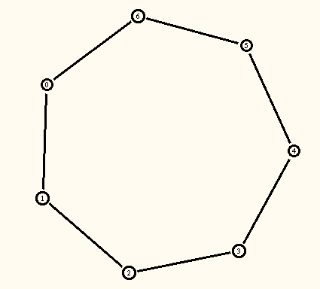
Wired Network- Dynamic
Network Topology

Slide 26
Simulator Creation and Tracing Activation
Creating a Simulator Object
set ns [new Simulator]
Tell the simulator to use dynamic routing
$ns rtproto DV
Setting up files for trace & NAM
set trace_nam [open out.nam w]
set trace_all [open all.tr w]
Tracing files using their commands
$ns namtrace-all $trace_nam
$ns trace-all $trace_all
Closing trace file and starting NAM
proc finish { } {
global ns trace_nam trace_all
$ns flush-trace
close $trace_nam $trace_all
exec nam out.nam & exit 0 }

Slide 27
Topology Creation
Creating seven nodes
for {set i 0} {$i < 7} {incr i} {
set n($i) [$ns node]
}
Create links between the nodes
for {set i 0} {$i < 7} {incr i} {
$ns duplex-link $n($i) $n([expr ($i+1)%7]) 1Mb 10ms DropTail
}

Slide 28
Attaching Agents
Create a UDP agent and attach it to node n(0)
set udp0 [new Agent/UDP]
$ns attach-agent $n(0) $udp0
Create a CBR traffic source and attach it to udp0
set cbr0 [new Application/Traffic/CBR]
$cbr0 set packetSize_ 500
$cbr0 set interval_ 0.005
$cbr0 attach-agent $udp0
Create a Null agent (a traffic sink) and attach it to node n(3)
set null0 [new Agent/Null]
$ns attach-agent $n(3) $null0
Connect the traffic source with the traffic sink
$ns connect $udp0 $null0

Slide 29
Traffic Generation
Schedule events for the CBR agent and the network dynamics
$ns at 0.5 "$cbr0 start"
$ns rtmodel-at 1.0 down $n(1) $n(2)
$ns rtmodel-at 2.0 up $n(1) $n(2)
$ns at 4.5 "$cbr0 stop“
Call the finish procedure after 5 seconds of simulation time
$ns at 5.0 "finish"
Run the simulation
$ns run

Slide 30
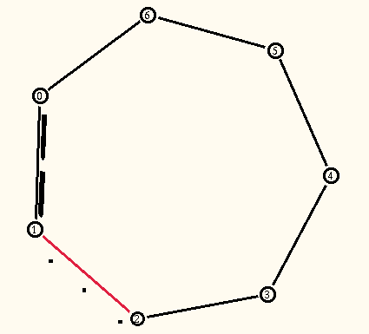
Wired Network- Dynamic
Packet Drops due to link failure

Slide 31
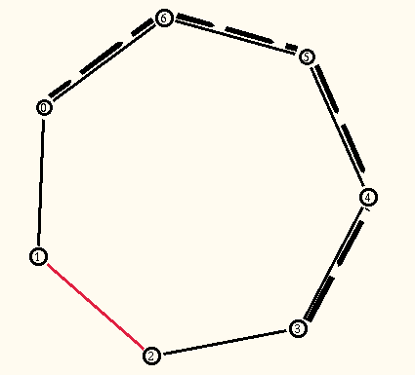
Wired Network- Dynamic
Dynamic Route Recovery

Slide 32
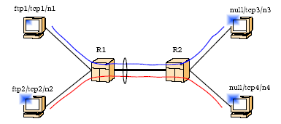
Wired Network
Network/Traffic Topology

Slide 33
Simulator Creation
Creating a Simulator Object
set ns [new Simulator]
Setting up files for trace & NAM
set trace_nam [open out.nam w]
set trace_all [open all.tr w]
Tracing files using their commands
$ns namtrace-all $trace_nam
$ns trace-all $trace_all
Closing trace file and starting NAM
proc finish { } {
global ns trace_nam trace_all
$ns flush-trace
close $trace_nam
close $trace_all
exec nam out.nam &
exit 0 }

Slide 34
Topology Creation
Creating nodes
set n1 [$ns node]
set n2 [$ns node]
set n3 [$ns node]
set n4 [$ns node]
set r1 [$ns node]
set r2 [$ns node]
Creating links (topology)
$ns duplex-link $n1 $r1 2Mb 5ms DropTail
set DuplexLink0 [$ns link $n1 $r1]
$ns duplex-link $n2 $r1 2Mb 5ms DropTail
set DuplexLink1 [$ns link $n2 $r1]
$ns duplex-link $r1 $r2 1Mb 10ms DropTail
set DuplexLink2 [$ns link $r1 $r2]
$ns duplex-link $r2 $n3 2Mb 5ms DropTail
set DuplexLink3 [$ns link $r2 $n3]
$ns duplex-link $r2 $n4 2Mb 5ms DropTail
set DuplexLink4 [$ns link $r2 $n4]

Slide 35
Topology Creation
Orientation of links
$ns duplex-link-op $n1 $r1 orient right-down
$ns duplex-link-op $n2 $r1 orient right-up
$ns duplex-link-op $r1 $r2 orient right
$ns duplex-link-op $r2 $n3 orient right-up
$ns duplex-link-op $r2 $n4 orient right-down

Slide 36
Attaching Agents
Attaching tcp agent to node 1
set tcp1 [new Agent/TCP]
$ns attach-agent $n1 $tcp1
Attaching sink agent to node 3
set sink1 [new Agent/TCPSink]
$ns attach-agent $n3 $sink1
Connecting tcp agent and sink agent
$ns connect $tcp1 $sink1
Attaching tcp agent to node 2
set tcp2 [new Agent/TCP]
$ns attach-agent $n2 $tcp2
Attaching sink agent to node 4
set sink2 [new Agent/TCPSink]
$ns attach-agent $n4 $sink2
Connecting tcp agent and sink agent
$ns connect $tcp2 $sink2

Slide 37
Traffic Generation
Attaching Application (FTP)
set ftp0 [new Application/FTP]
$ftp0 attach-agent $tcp1
set ftp1 [new Application/FTP]
$ftp1 attach-agent $tcp2
Schedule events for the FTP
$ns at 0.5 "$ftp0 start“
$ns at 0.5 "$ftp1 start“
$ns at 10.1 "$ftp0 stop“
$ns at 10.2 "$ftp1 stop“
Call the finish procedure after 10.3 seconds of simulation time
$ns at 10.3 "finish“
Run the simulation
$ns run

Slide 38
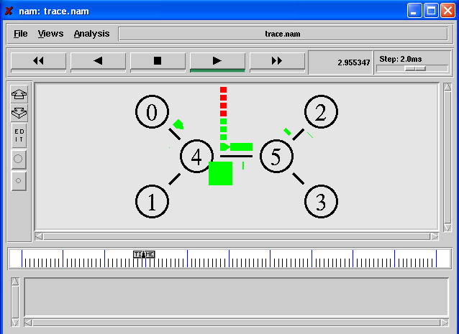
NAM Output

Slide 39
Wireless Networks: MANETs
Scenario
containing 2 mobile nodes
moving within 500mX500m flat topology
using AODV/DSR/DSDV ad hoc routing protocol
Random Waypoint mobility model
TCP and FTP traffic

Slide 40
Define Variables
# ======================================================================
# Define options
# ======================================================================
set val(chan) Channel/WirelessChannel ;# channel type
set val(prop) Propagation/TwoRayGround ;# radio-propagation model
set val(netif) Phy/WirelessPhy ;# network interface type
set val(mac) Mac/802_11 ;# MAC type
set val(ifq) Queue/DropTail/PriQueue ;# interface queue type
set val(ll) LL ;# link layer type
set val(ant) Antenna/OmniAntenna ;# antenna model
set val(ifqlen) 50 ;# max packet in ifq
set val(nn) 2 ;# number of mobilenodes
set val(rp) DSDV ;# routing protocol

Slide 41
Simulator Creation
# Create Simulator
set ns_ [new Simulator]
# Setting up files for trace & NAM
set tracefd [open simple.tr w]
set namtrace [open simple.nam w]
# Tracing files using their commands
$ns_ trace-all $tracefd
$ns_ namtrace-all-wireless $namtrace 500 500
# Closing trace file and starting NAM
proc stop {} {
global ns_ tracefd namtrace
$ns_ flush-trace
close $tracefd
close $namtrace
exec nam simple.nam & exit 0
}

Slide 42
Create Topology
# set up topography object
set topo [new Topography] #Create topology
$topo load_flatgrid 500 500 #Create Topological Boundary (500 m X 500 m)
# Create God
create-god $val(nn)

Slide 43
Configure Node
$ns_ node-config -adhocRouting $val(rp) \
-llType $val(ll) \
-macType $val(mac) \
-ifqType $val(ifq) \
-ifqLen $val(ifqlen) \
-antType $val(ant) \
-propType $val(prop) \
-phyType $val(netif) \
-channelType $val(chan) \
-topoInstance $topo \
-agentTrace ON \
-routerTrace ON \
-macTrace OFF \
-movementTrace OFF
for {set i 0} {$i < $val(nn) } {incr i} {
set node_($i) [$ns_ node]
$node_($i) random-motion 0 ;# disable random motion
$ns_ initial_node_pos $node_($i) 25
}

Slide 44
Node Position and Mobility
# Provide initial (X,Y, for now Z=0) co-ordinates for mobile nodes
$node_(0) set X_ 5.0
$node_(0) set Y_ 2.0
$node_(0) set Z_ 0.0
$node_(1) set X_ 390.0
$node_(1) set Y_ 385.0
$node_(1) set Z_ 0.0
# Now produce some simple node movements
# Node_(1) starts to move towards node_(0)
$ns_ at 50.0 "$node_(1) setdest 25.0 20.0 15.0"
$ns_ at 10.0 "$node_(0) setdest 20.0 18.0 1.0"
# Node_(1) then starts to move away from node_(0)
$ns_ at 100.0 "$node_(1) setdest 490.0 480.0 15.0"

Slide 45
Traffic Generation
# Setup traffic flow between nodes
# TCP connections between node_(0) and node_(1)
set tcp [new Agent/TCP]
$tcp set class_ 2
set sink [new Agent/TCPSink]
$ns_ attach-agent $node_(0) $tcp
$ns_ attach-agent $node_(1) $sink
$ns_ connect $tcp $sink
set ftp [new Application/FTP]
$ftp attach-agent $tcp
$ns_ at 10.0 "$ftp start"

Slide 46
End Simulation
# Tell nodes when the simulation ends
#
for {set i 0} {$i < $val(nn) } {incr i} {
$ns_ at 150.0 "$node_($i) reset";
}
$ns_ at 150.0 "stop"
$ns_ at 150.01 "puts \"NS EXITING...\" ; $ns_ halt“
puts "Starting Simulation..."
$ns_ run

Slide 47
Scenario Generator: Mobility
Mobile Movement Generator
Syntax: ./setdest -n <num_of_nodes> -p <pausetime> -M <maxspeed> -t <simtime> -x <maxx> -y <maxy> > <movment-file>
Example: ./setdest -n 20 -p 2.0 -M 10.0 -t 200 -x 500 -y 500 > scen-20-test
Source Directory: ns-2/indep-utils/cmu-scen-gen/setdest/
Inclusion in TCL script: source <movement-file>
Random movement
$node random-motion 1
$node start

Slide 48
A Movement Scenario: scen-20-test
$node_(2) set Z_ 0.000000000000
$node_(2) set Y_ 199.373306816804
$node_(2) set X_ 591.256560093833
$node_(1) set Z_ 0.000000000000
$node_(1) set Y_ 345.357731779204
$node_(1) set X_ 257.046298323157
$node_(0) set Z_ 0.000000000000
$node_(0) set Y_ 239.438009831261
$node_(0) set X_ 83.364418416244
$ns_ at 50.000000000000 "$node_(2) setdest 369.463244915743 170.519203111152 3.371785899154"
$ns_ at 51.000000000000 "$node_(1) setdest 221.826585497093 80.855495003839 14.909259208114"
$ns_ at 33.000000000000 "$node_(0) setdest 89.663708107313 283.494644426442 19.153832288917"

Slide 49
Scenario Generator: Traffic
Generating traffic pattern files
CBR/TCP traffic
ns cbrgen.tcl [-type cbr|tcp] [-nn nodes] [-seed seed] [-mc connections] [-rate rate] > [file-name]
CBR traffic
ns cbrgen.tcl –type cbr –nn 20 –seed 1 –mc 8 - rate 4 > cbr-20-test
TCP traffic
ns cbrgen.tcl –type tcp -nn 15 -seed 0 –mc 6 > tcp-15-test
Source Directory: ns-2/indep-utils/cmu-scen-gen/
Inclusion in TCL file:
source <traffic-scenario-file>

Slide 50
A Traffic Scenario: cbr-20-test
set udp_(0) [new Agent/UDP]
$ns_ attach-agent $node_(0) $udp_(0)
set null_(0) [new Agent/Null]
$ns_ attach-agent $node_(2) $null_(0)
set cbr_(0) [new Application/Traffic/CBR]
$cbr_(0) set packetSize_ 512
$cbr_(0) set interval_ 4.0
$cbr_(0) set random_ 1
$cbr_(0) set maxpkts_ 10000
$cbr_(0) attach-agent $udp_(0)
$ns_ connect $udp_(0) $null_(0)
$ns_ at 127.93667922166023 "$cbr_(0) start"
…….

Slide 51
Energy Extension
Node is energy-aware
Define node by adding new options:
$ns_ node-config \
–energyModel EnergyModel
-initialEnergy 100.0
-txPower 0.6
-rxPower 0.2

Slide 52
Further Reading
Jae Chung and Mark Claypool, NS by Example, http://nile.wpi.edu/NS/
The ns manual, http://www.isi.edu/nsnam/ns/ns-documentation.html
Marc Greis' Tutorial for the Network Simulator ns, http://www.isi.edu/nsnam/ns/tutorial/

